Slide 1
CSE 524 Advanced Project
Mitesh Sanjay Jalan

Slide 2
Replication of Research Paper
Lyu W, Dong X, Wong R, Zheng S, Abell-Hart K, Wang F, Chen C. A Multimodal Transformer: Fusing Clinical Notes with Structured EHR Data for Interpretable In-Hospital Mortality Prediction. AMIA Annu Symp Proc. 2023 Apr 29;2022:719-728. PMID: 37128451; PMCID: PMC10148371.

Slide 3
Summary of paper
Use Clinical BERT (Fined-tuned on MIMIC-III) for generation of Input embeddings.
Using Multimodal embedding (3 encoders in transformer block were used: One for each clinical notes and EHR(structured data) , finally one for concatenation of both the previous encoders.
The final output from Multimodal Encoder (48 encodings for 48 hours) is passed to transformer layer and the output form the transformer let’s say TMM concatenated to the clinical note embedding to generate a prediction(Binary output[Risk of Mortality]).

Slide 4
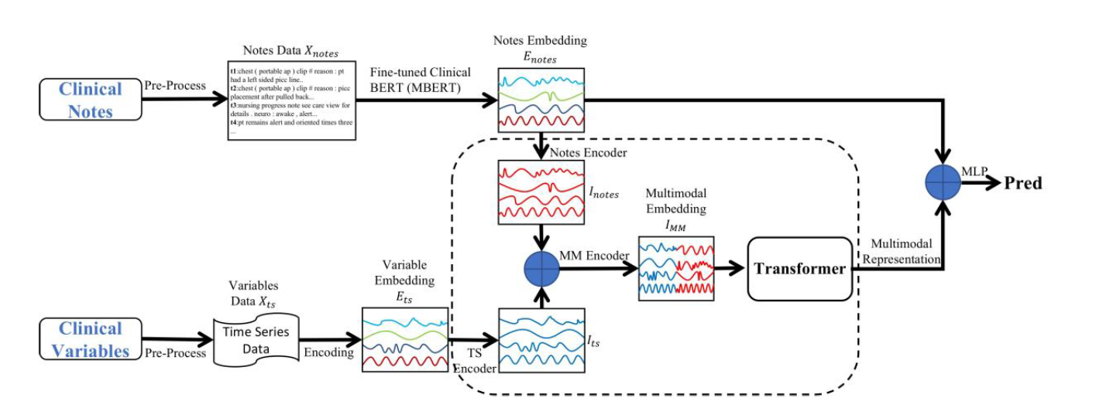
Architecture of paper

Slide 5
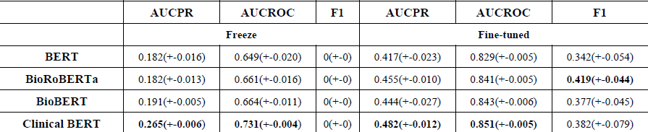
Results in Paper

Slide 6
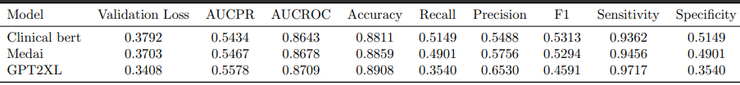
Experiments with different LLM models
The clinical BERT model is the one already present in the research paper.
Tried 2 different LLM models with same architecture to find out if there is a better model in existence than that in the paper.
The recall which is basically the representation of patient with class (1) labeled as class(1) correctly by model, according to me is the most important as we cannot discharge patients at risk of death.
The output of my experiments{ MedAI , GPT2XL} compared with the Clinical Bert Model:

Slide 7
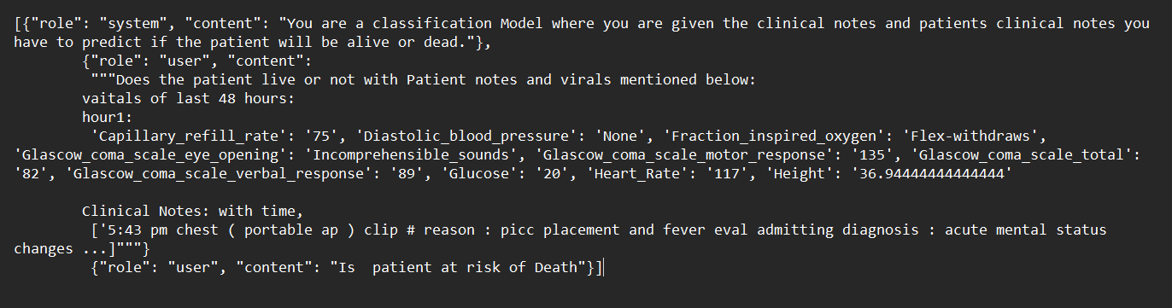
Experiment with the GPT4 Model
CSE-524-Mortality-risk-prediction/GPT4 Azure/GPT4-azure.ipynb at main · MiteshJalan/CSE-524-Mortality-risk-prediction (github.com)
The GPT4 model is a chat based LLM model which means it can only accept the data and instructions in the form of Prompt.
Because of this reason the GPT4 model is not able to generate any output from the given input clinical notes and structured data.

Slide 8
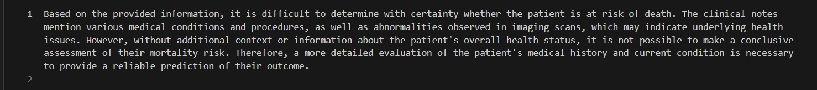
Output (inconclusive)

